Slide 1
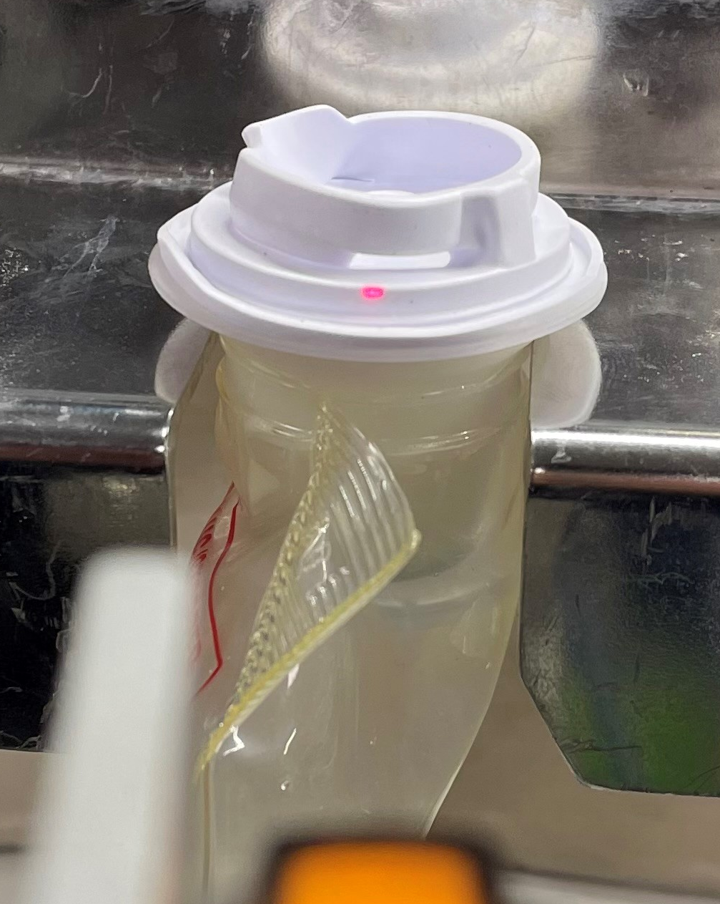
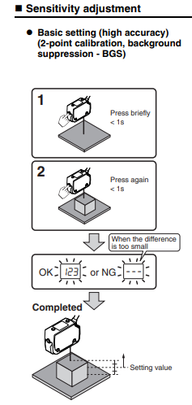
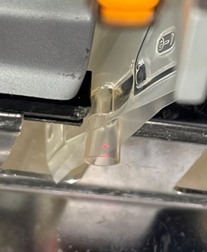
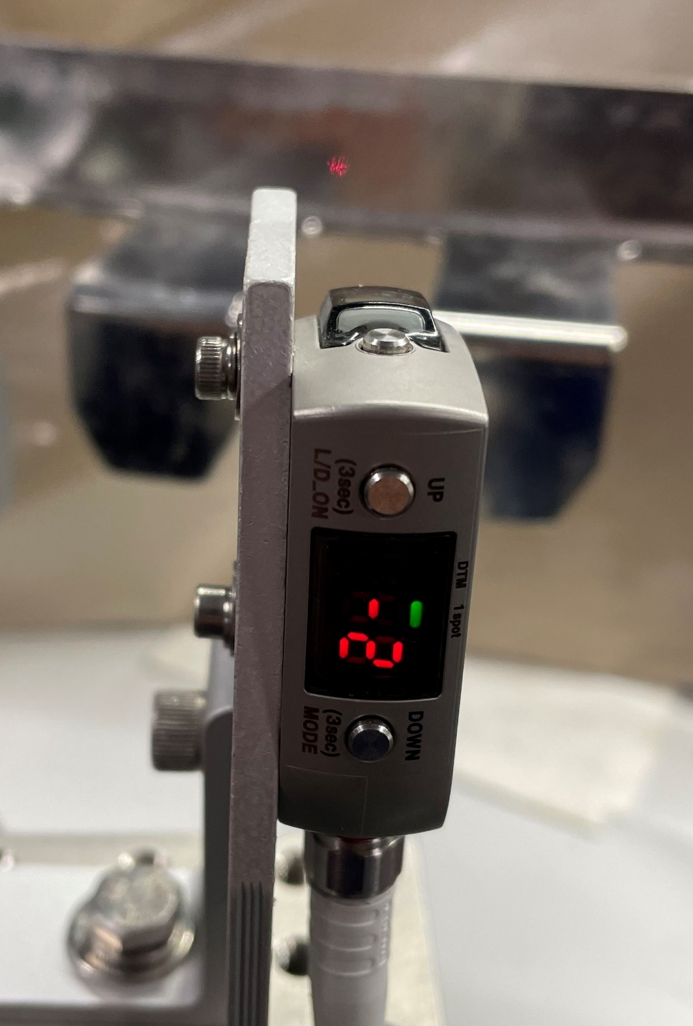
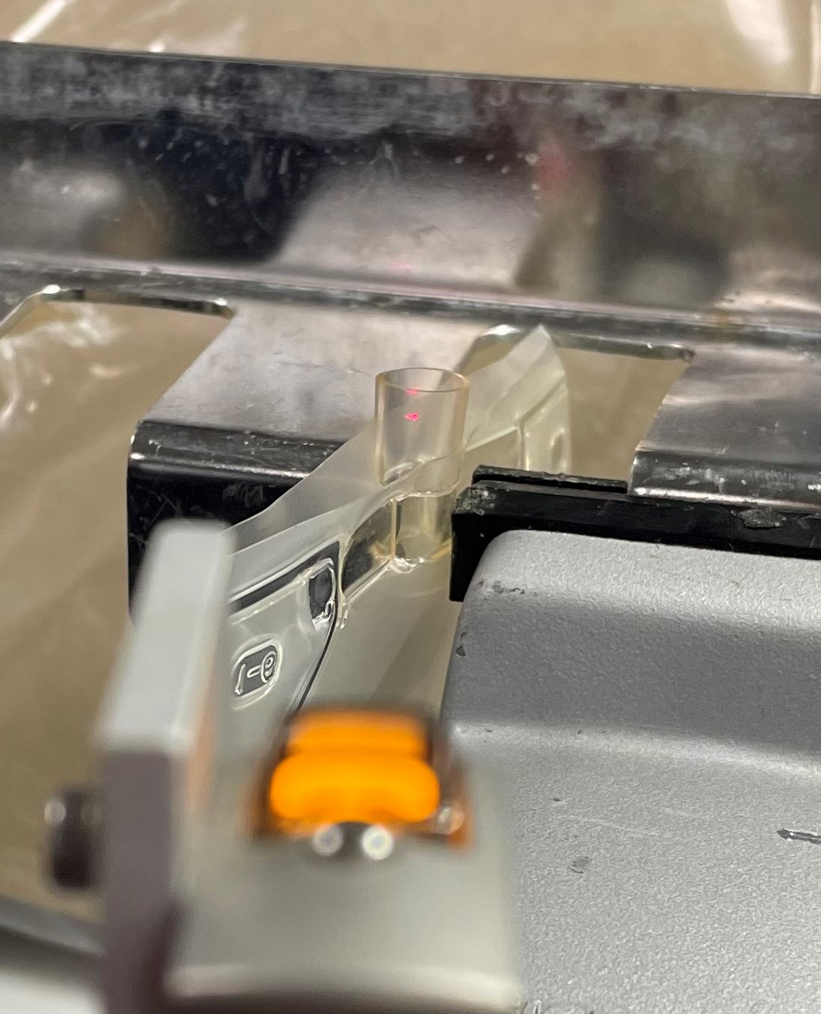
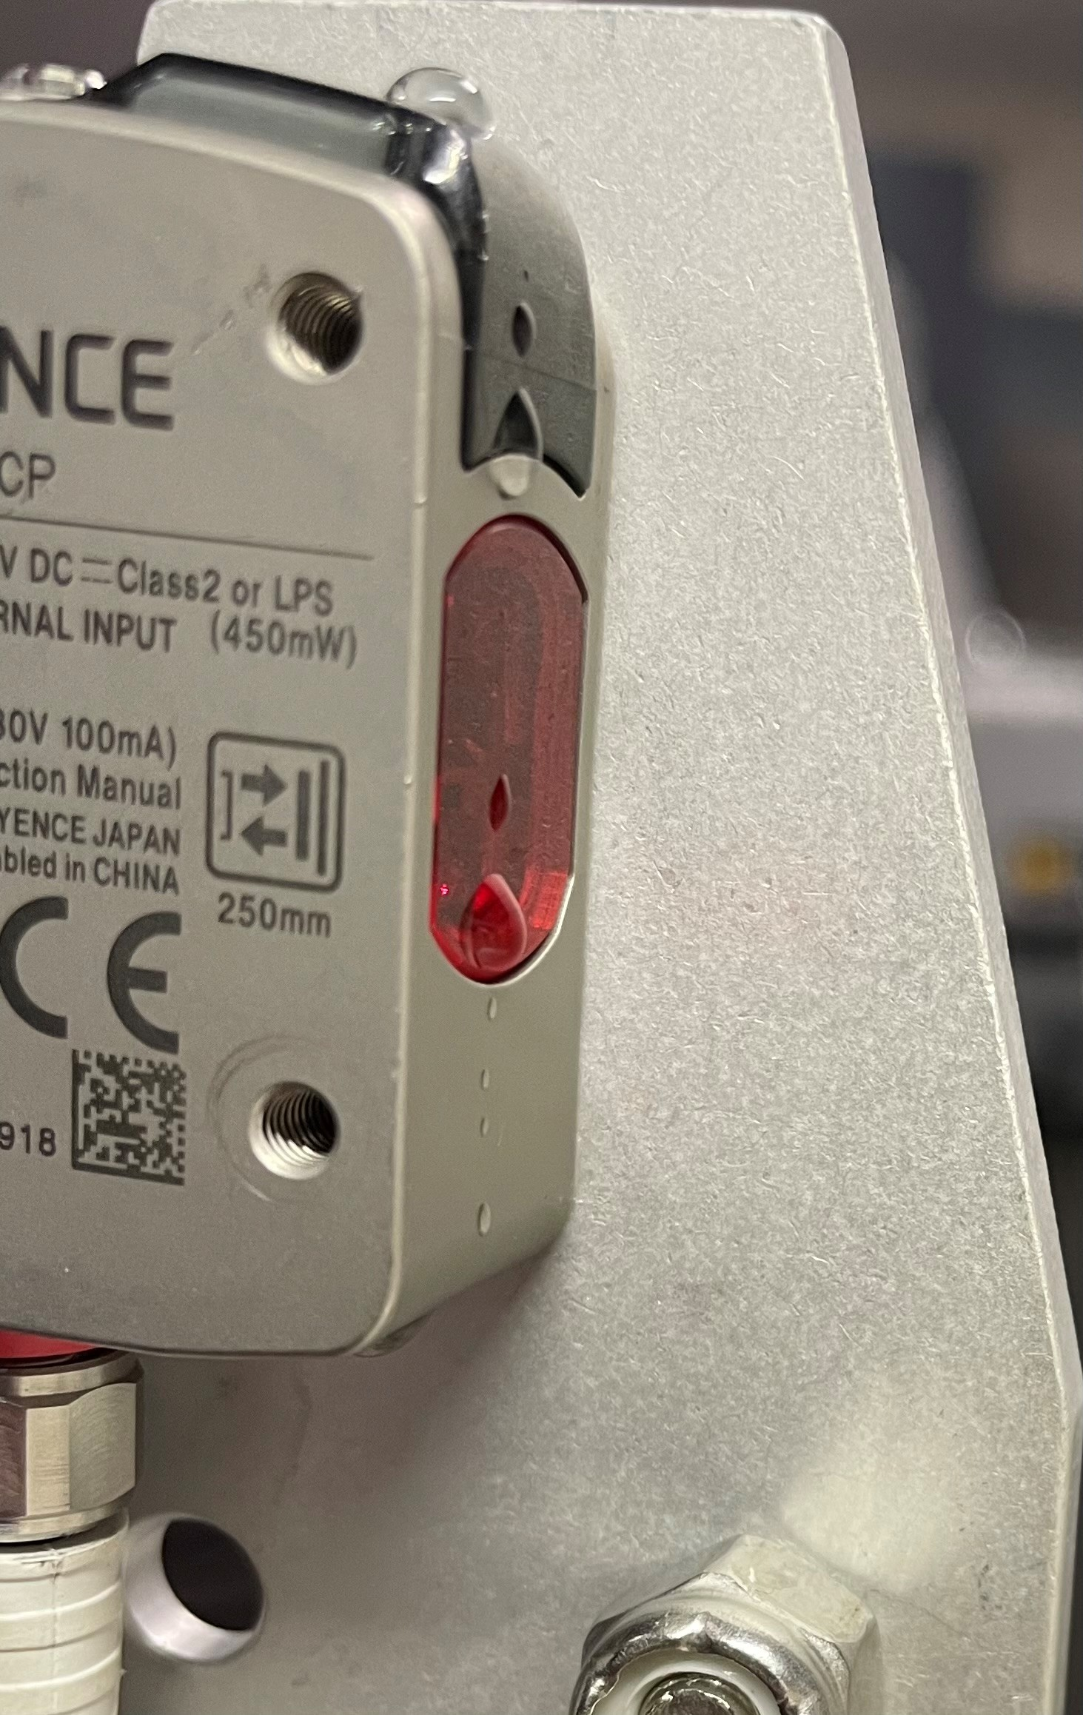
AddV Filler Vial Port Sensor Alignment And Teaching
Ver. 1.2 Pat McD. 6/23
The Vial Port and the Bag Present Sensors read when the machine is at 4.0 degrees or any 22.5-degree increment after 4.0. See Table 1.
Center the visible laser of the sensors (both the Vial Port Sensor & the Bag Present Sensor) as shown below in Fig. #1 and Fig. #2.
Reliable Vial Port Detection occurs when both the Tube Sensor (Bag Present) and the Vial Port Sensor are on simultaneously at 4.0 degrees and every 22.5 degrees thereafter. **22.5 Mechanical Degrees is the distance between each clamp.**
Fig. #1
The Vial Port Sensor (Upper) will trigger on the tips of the Carrier Rake. This is unavoidable with the current design. These triggers are outside of the PLC timing “window” and should not affect the Vial Port Detection. The Missing Vial Port Alarm should trigger only when the Bag Present Sensor (lower) detects a bag (Fig. #2) while the Vial Port Sensor (upper) does not (Fig. #5).
Teach Sensor using the method below Fig. # 3. Remove Bag and press of the “SET” button briefly. With bag in place, press the “SET” button again briefly. **See Note #1**
Fig. #3
**Note #1 : The lens of the sensor must be free of water droplets before teaching!
Water droplets can diffuse the laser beam. Fig. #4
Fig. #2
Fig. #5
Table #1
Fig. #2

